Slide 1
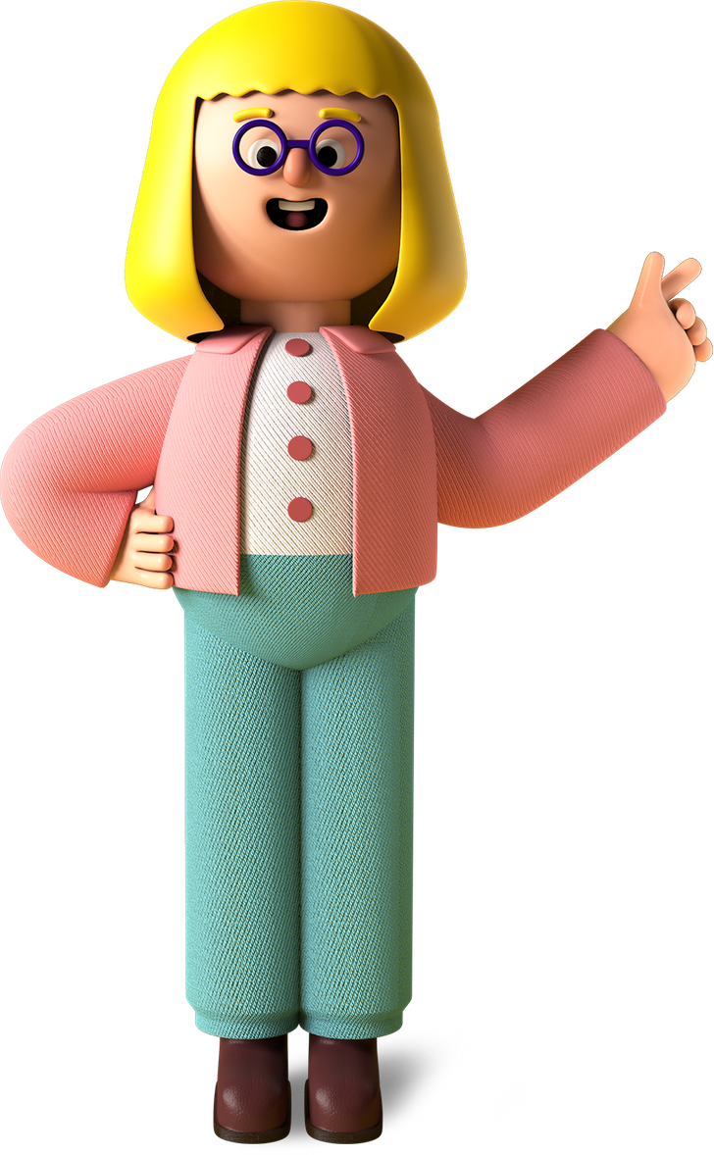


Student
Project

Slide 2

Project Name
Make my own city

Slide 3
Project Link
https://editor.p5js.org/student123/sketches/1w494Zsch

Slide 4

My favorite part about the project
1. The building were arranged nicely by me.
2. Fun to create the number of floors.

Slide 5

What I learned from it
01
Object oriented style of programming
02
Learnt about the class file and the object files
03
Learnt how to give properties to an object in Javascript language

Slide 6

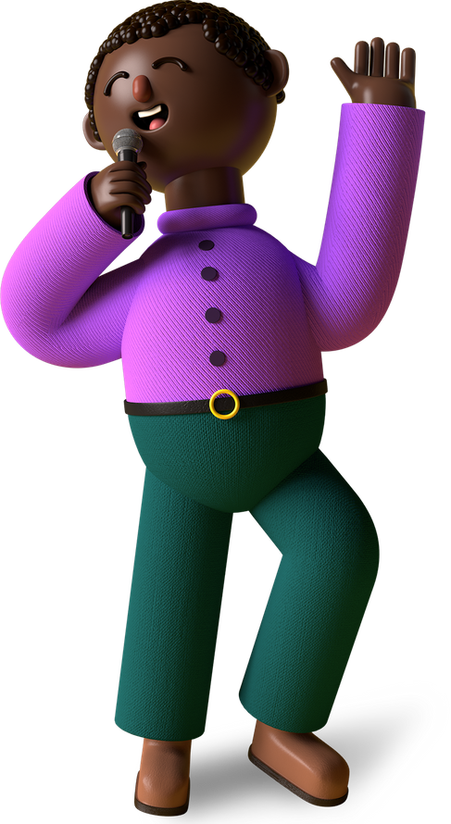
Thank You, Merry X’Mas & A Happy New Year From Remanika,
A Young Coder In The Making!

